Slide 1
BIO 5100 Project Title: Using ChatGPT to create a Shiny App for Estimation of Peptide Concentration in a Sample.
PRESENTER: EMMANUEL TOBECHUKWU UGWUOJI
MARCH 27, 2024

Slide 2
RESEARCH QUESTION
Is there any relationship between peptide concentrations and fluorescent intensity of samples?
If a relationship exists, what is the strength of the relationship between the variables?
Can peptide concentration be estimated using the fluorescent reads?
Can ChatGPT help to develop a tool to visualize the relationship between the two variables?

Slide 3
SPECIFIC OBJECTIVES
To attempt to build a Shiny App that generates a scatter plot that shows the relationship between the two variables.
To include in the plot a line of regression.
To ensure that the generated code displays the r-squared value indicative of the strength of the relationship between the two variables.
To be able to estimate peptide concentration using fluorescent reads.
To document and understand which kind of prompt can lead ChatGPT to produce useful or not useful code

Slide 4
SPECIFIC OBJECTIVES
To attempt to build a Shiny App that generates a scatter plot that shows the relationship between the two variables.
To include in the plot a line of regression.
To ensure that the generated code displays the r-squared value indicative of the strength of the relationship.
To be able to estimate peptide concentration using fluorescent reads.
To document and understand which kind of prompt can lead ChatGPT to produce useful or not useful code

Slide 5
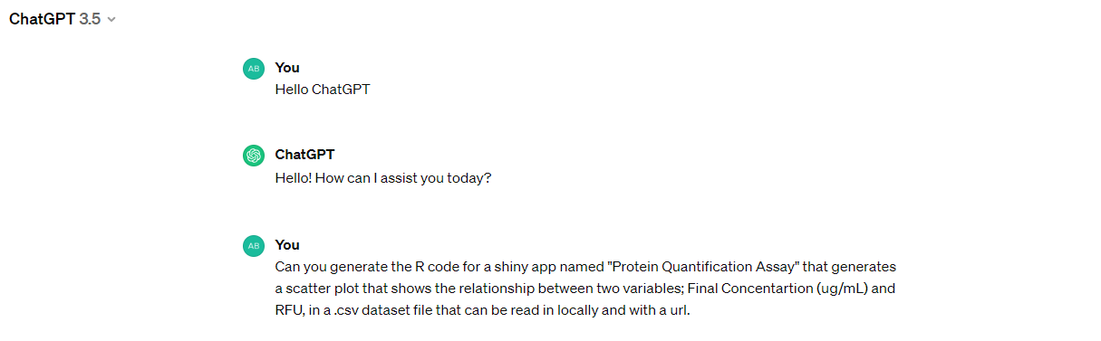
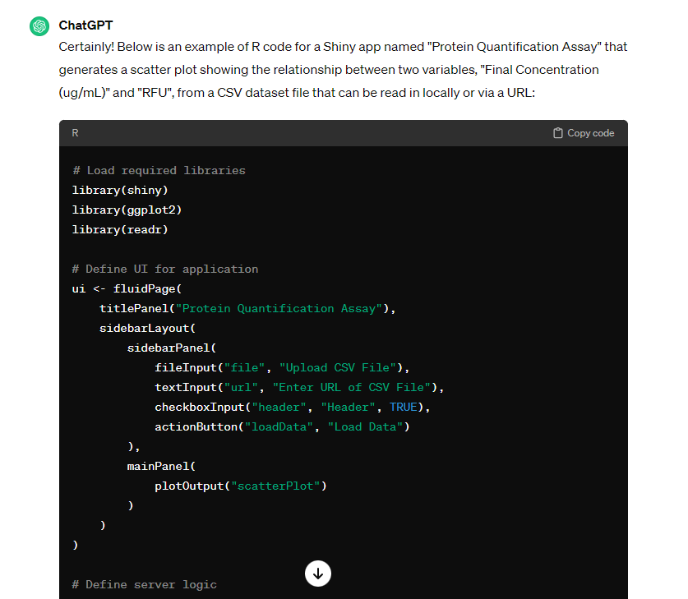
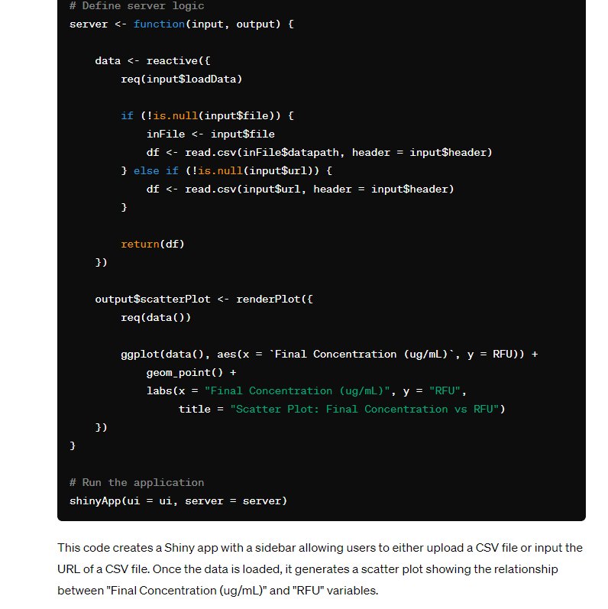

Slide 6
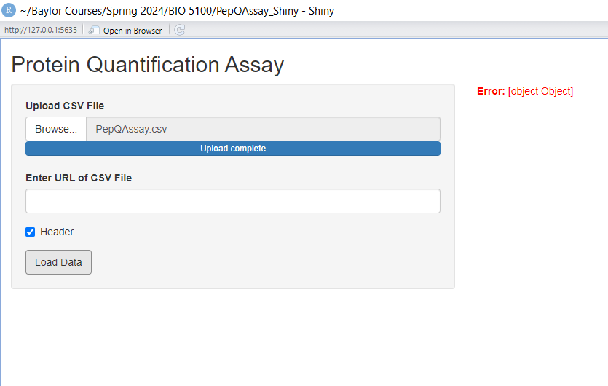
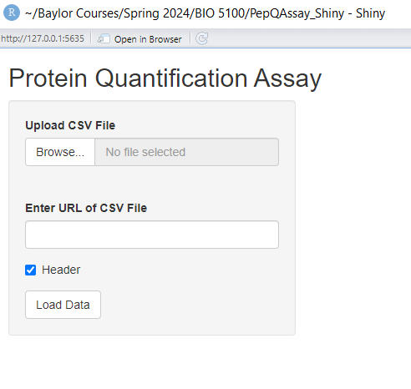
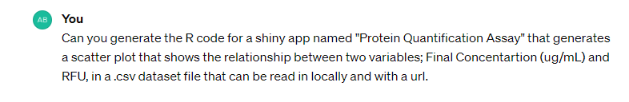

Slide 7
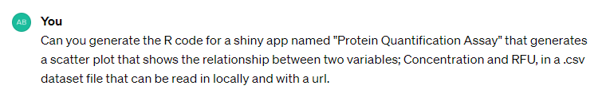
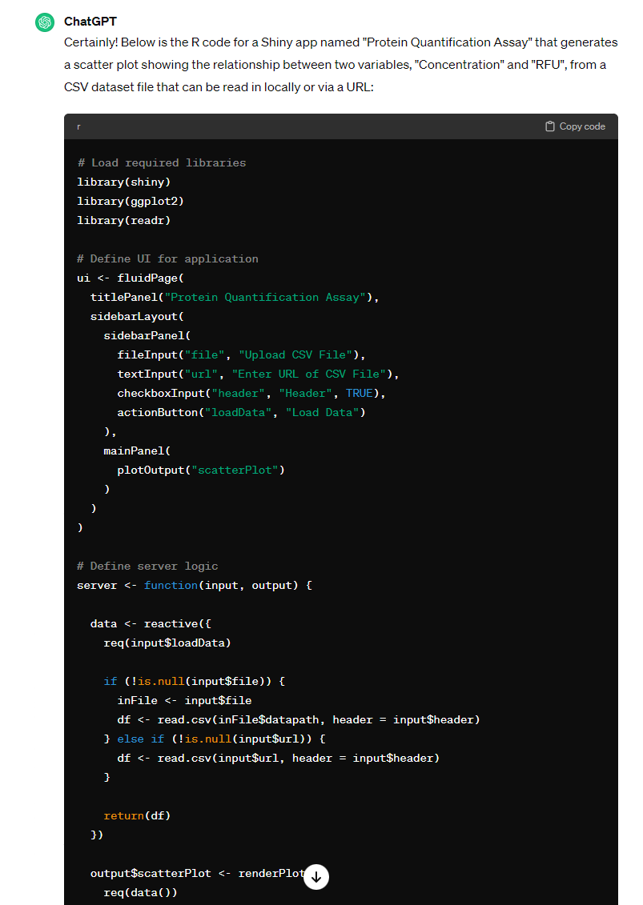
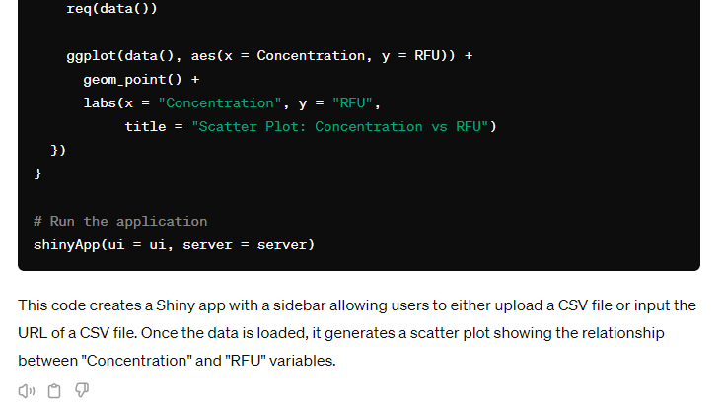

Slide 8
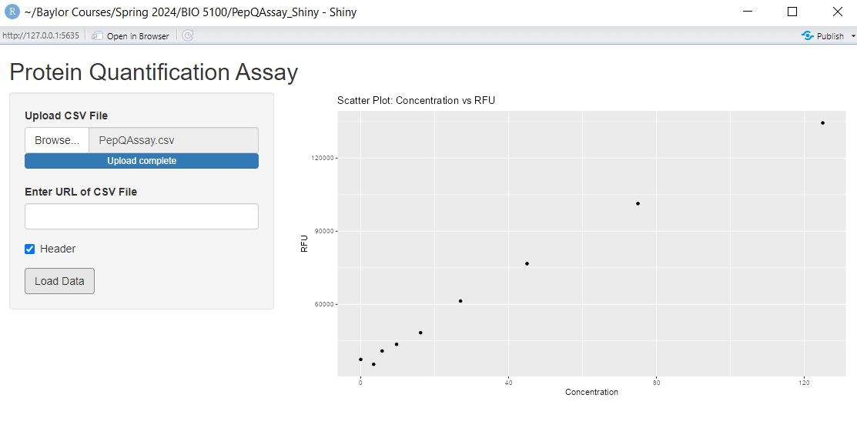
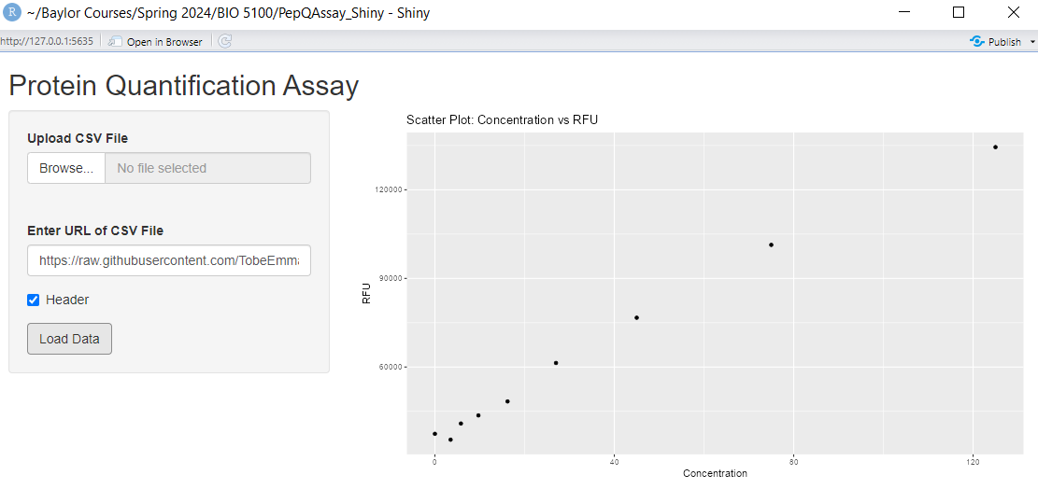

Slide 9
SPECIFIC OBJECTIVES
To attempt to build a Shiny App that generates a scatter plot that shows the relationship between the two variables.
To include in the plot a line of regression.
To ensure that the generated code displays the r-squared value indicative of the strength of the relationship.
To be able to estimate peptide concentration using fluorescent reads.
To document and understand which kind of prompt can lead ChatGPT to produce useful or not useful code

Slide 10

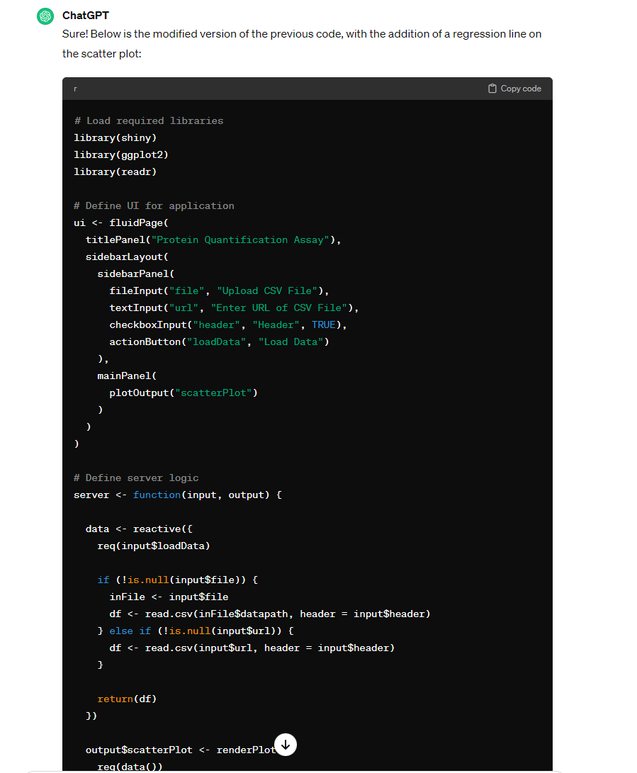
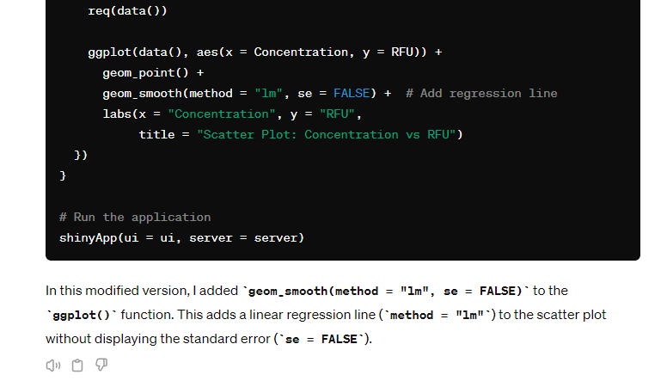

Slide 11
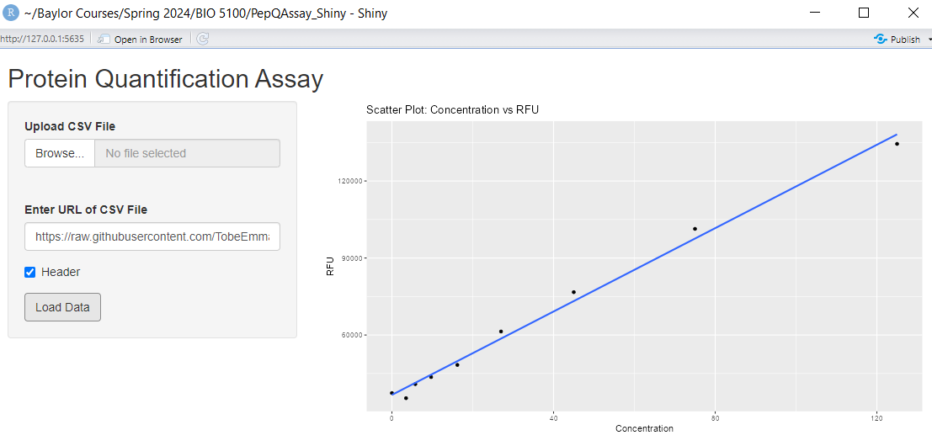
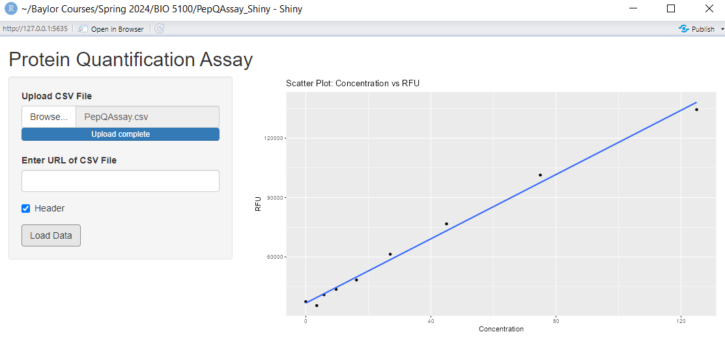

Slide 12
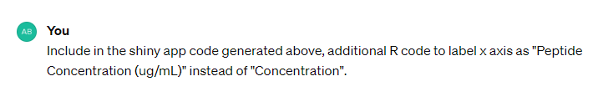
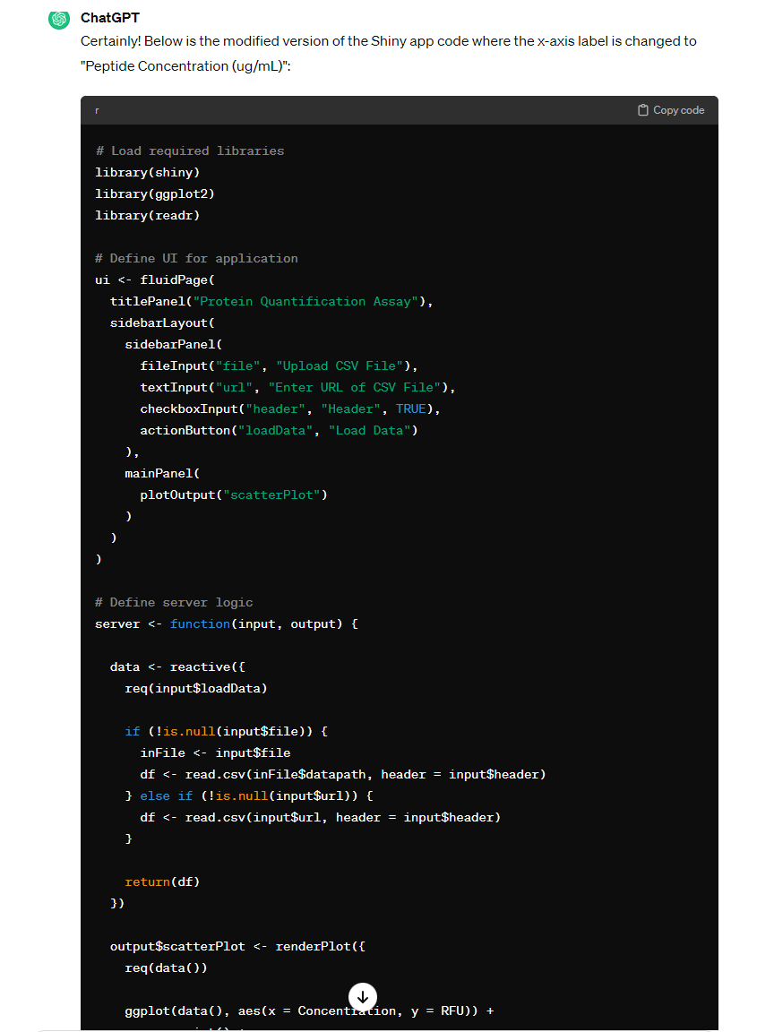
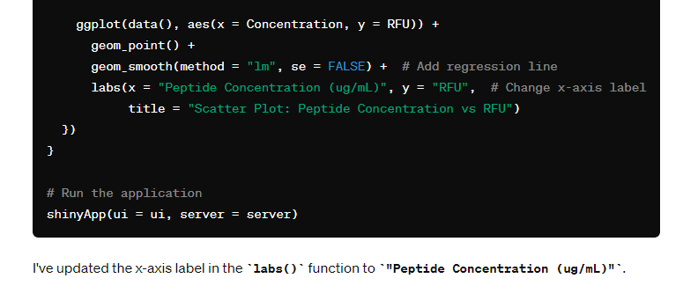

Slide 13
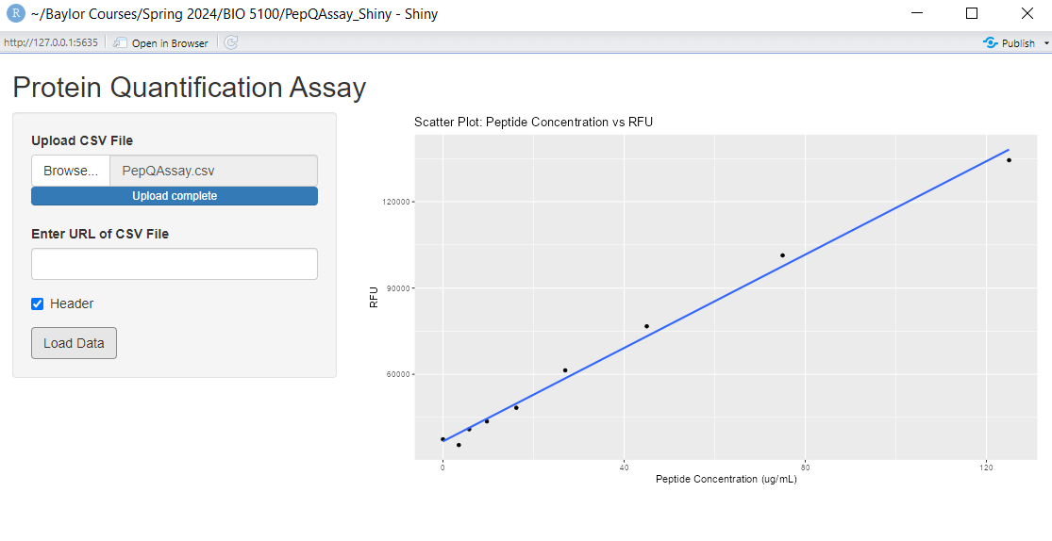

Slide 14
SPECIFIC OBJECTIVES
To attempt to build a Shiny App that generates a scatter plot that shows the relationship between the two variables.
To include in the plot a line of regression.
To ensure that the generated code displays the r-squared value indicative of the strength of the relationship.
To be able to estimate peptide concentration using fluorescent reads.
To document and understand which kind of prompt can lead ChatGPT to produce useful or not useful code

Slide 15
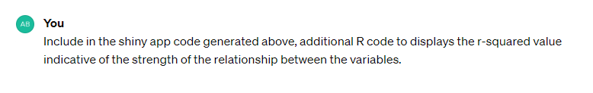
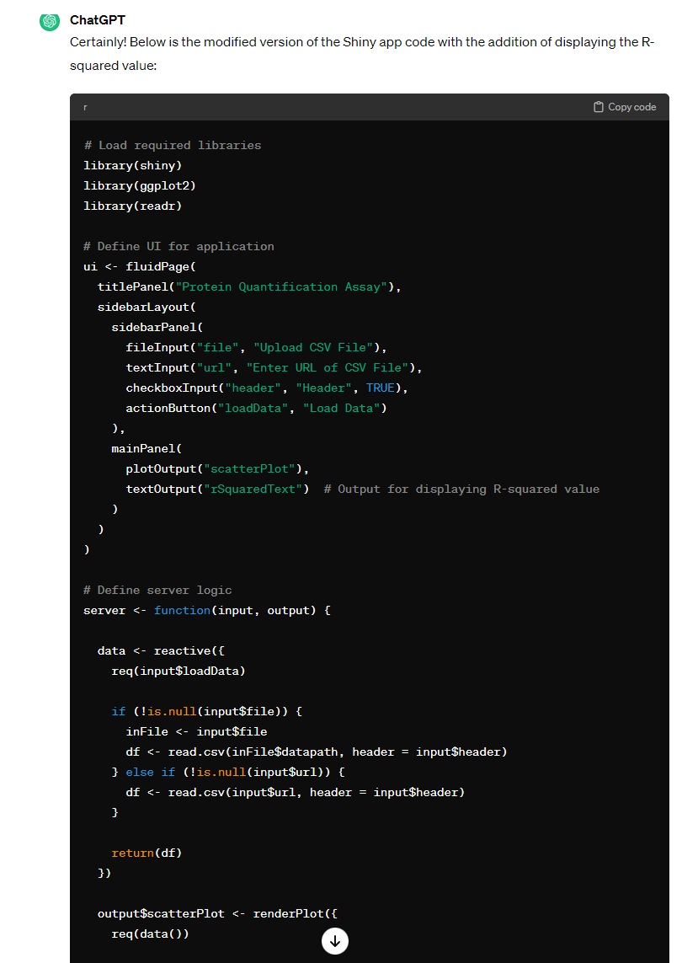
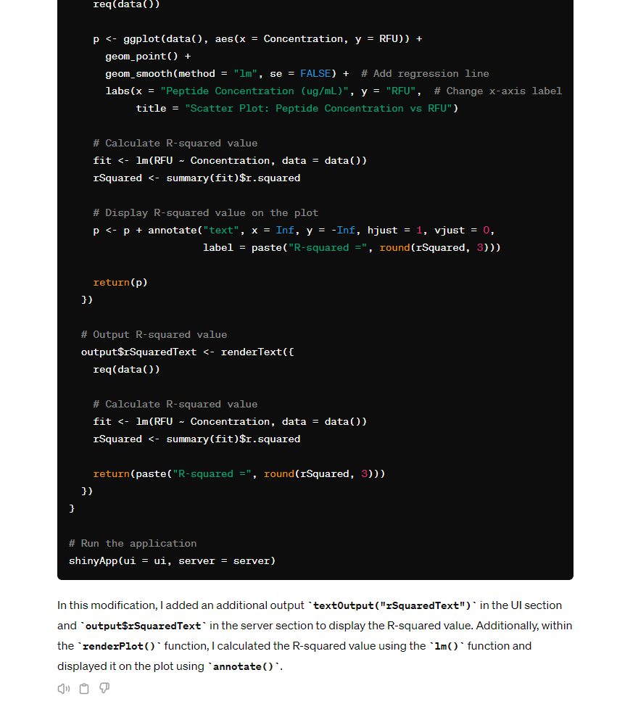

Slide 16
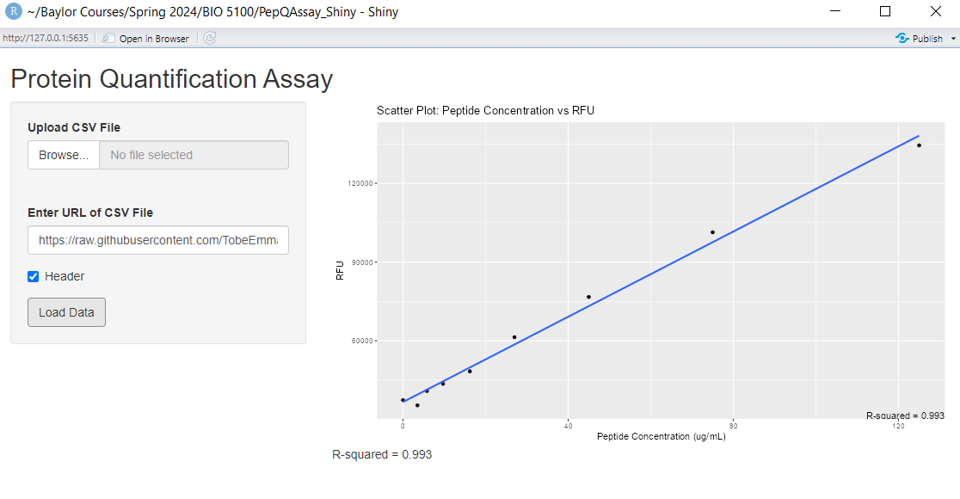

Slide 17
SPECIFIC OBJECTIVES
To attempt to build a Shiny App that generates a scatter plot that shows the relationship between the two variables.
To include in the plot a line of regression.
To ensure that the generated code displays the r-squared value indicative of the strength of the relationship.
To be able to estimate peptide concentration using fluorescent reads.
To document and understand which kind of prompt can lead ChatGPT to produce useful or not useful code

Slide 18
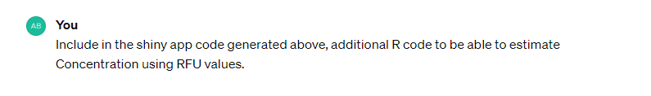
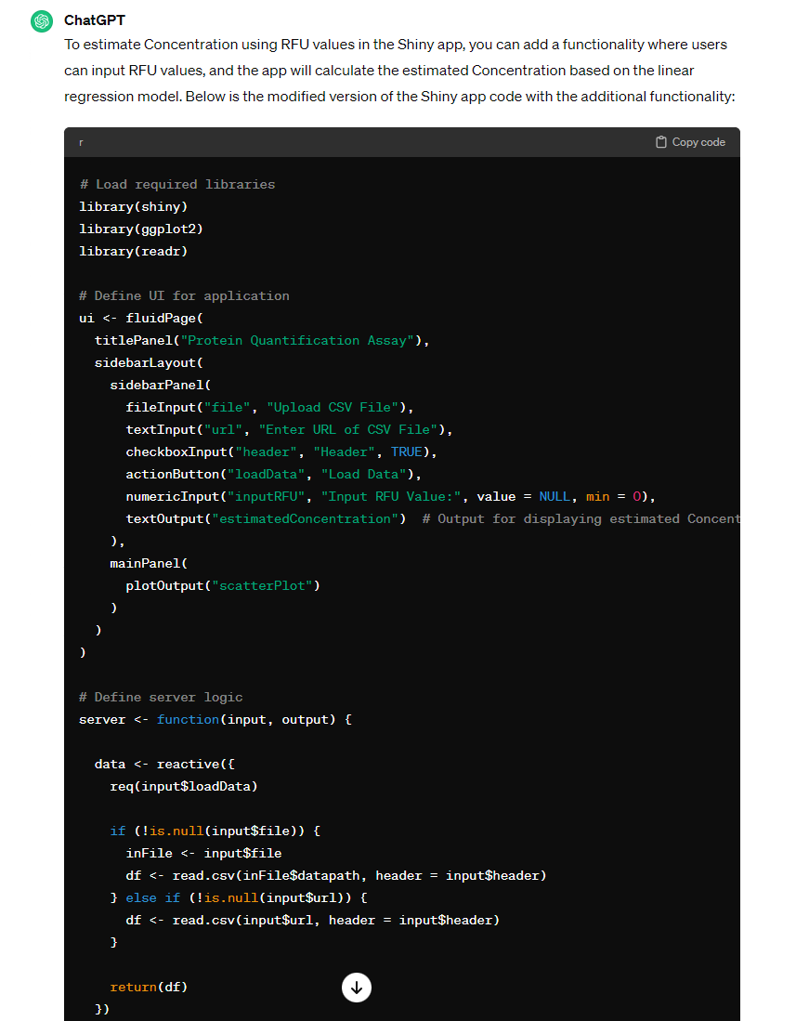
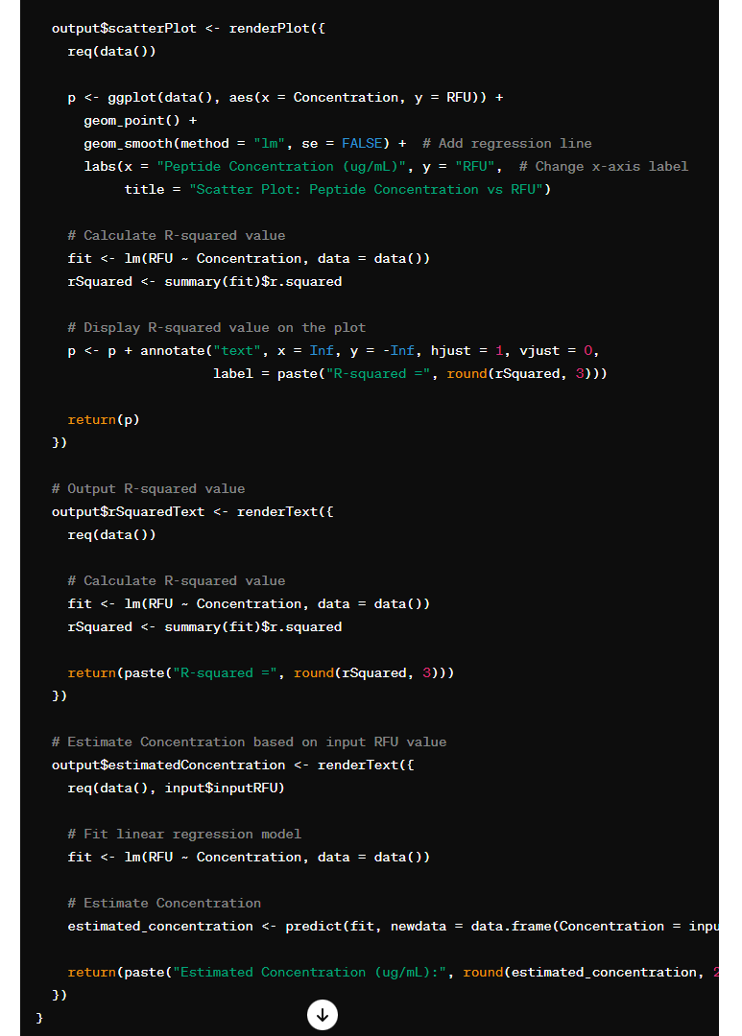
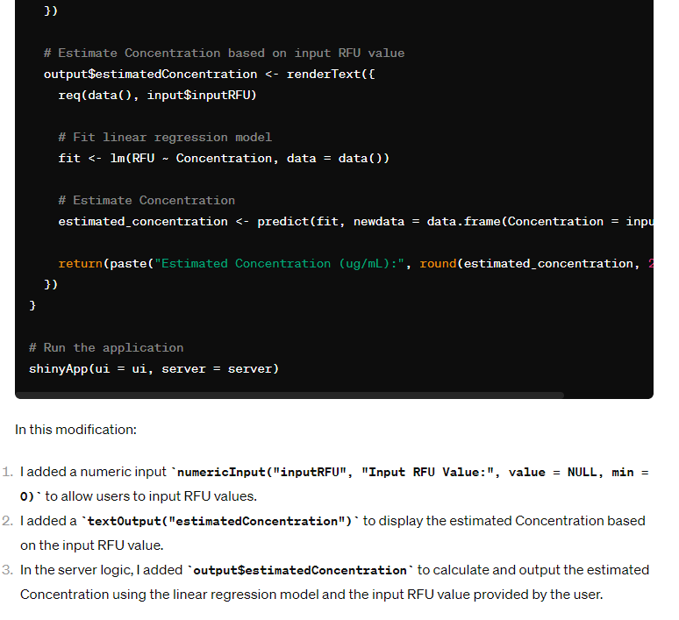

Slide 19
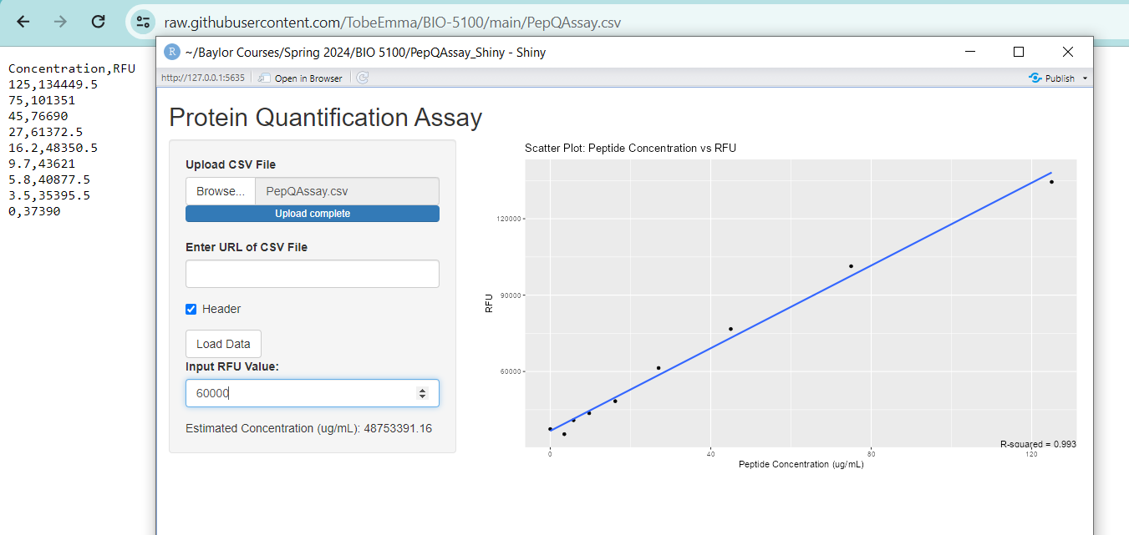
Incorrect Estimate

Slide 20
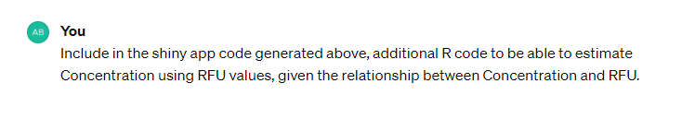
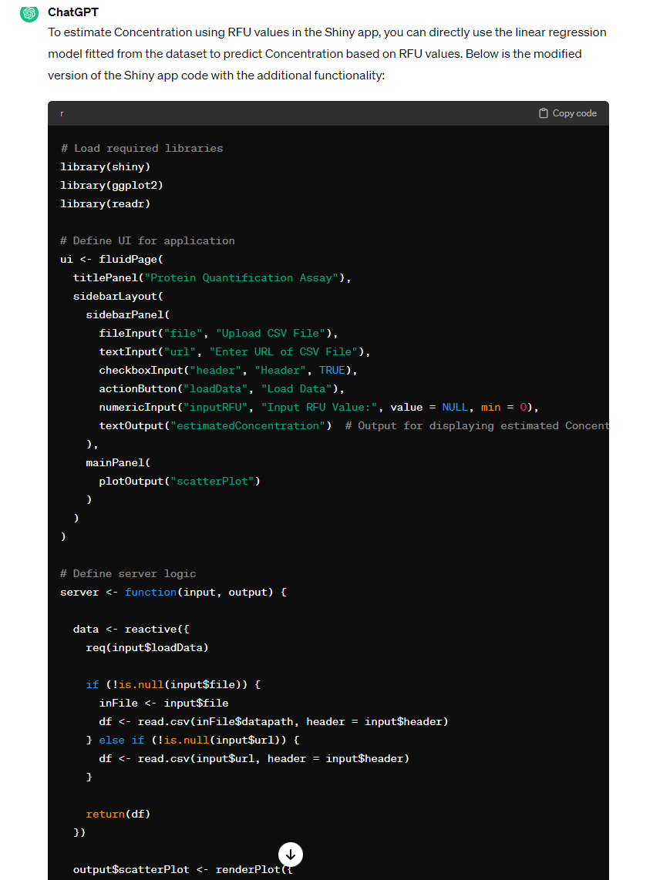
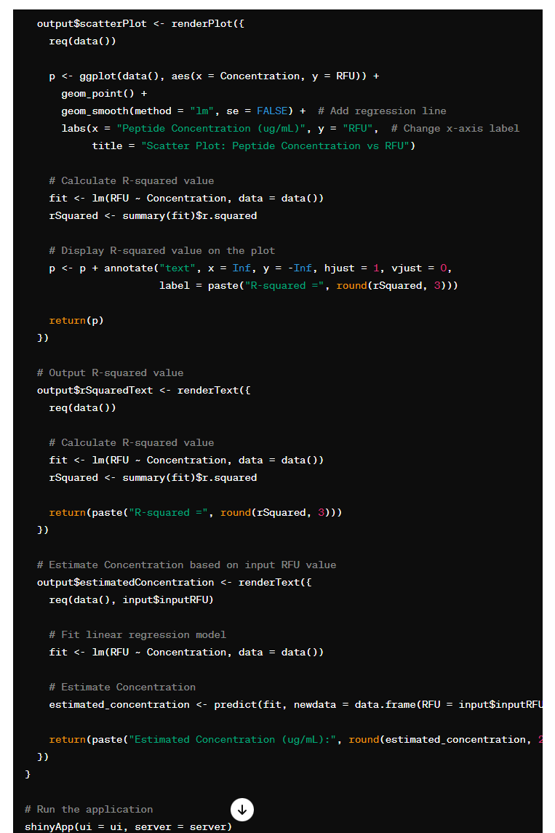
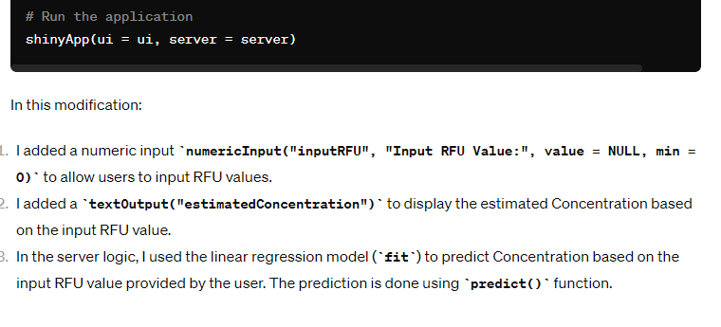

Slide 21
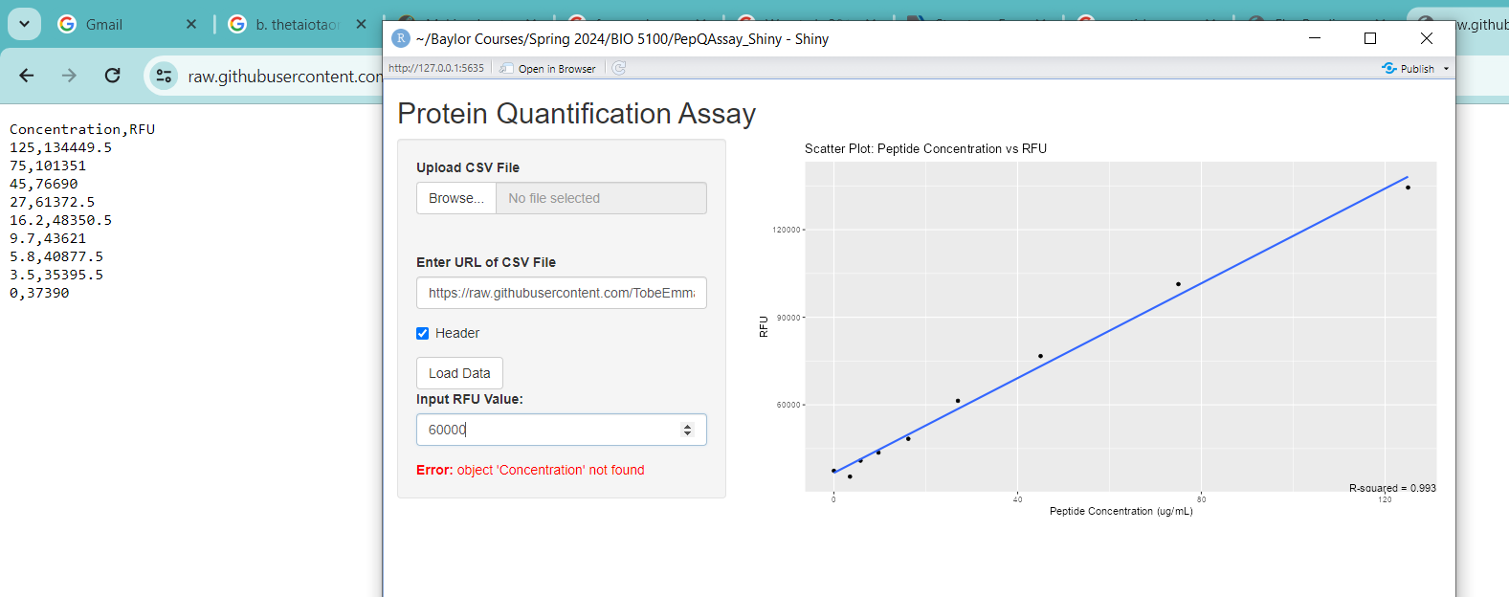
Returns Error

Slide 22
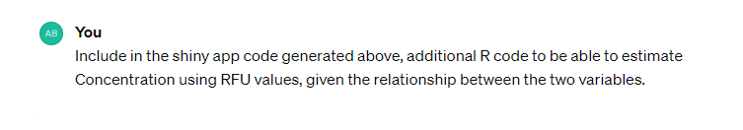
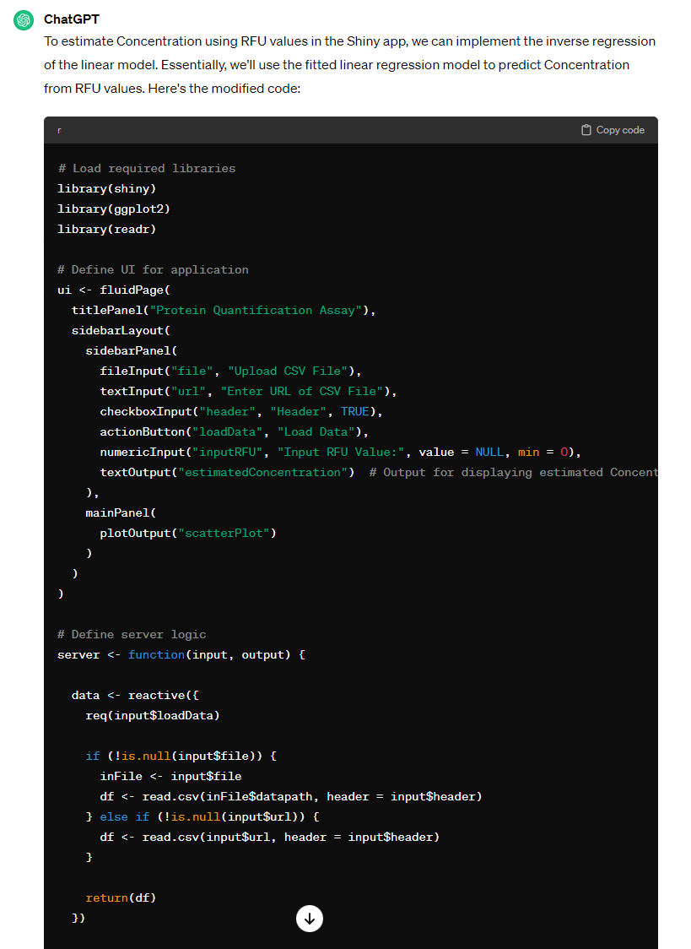
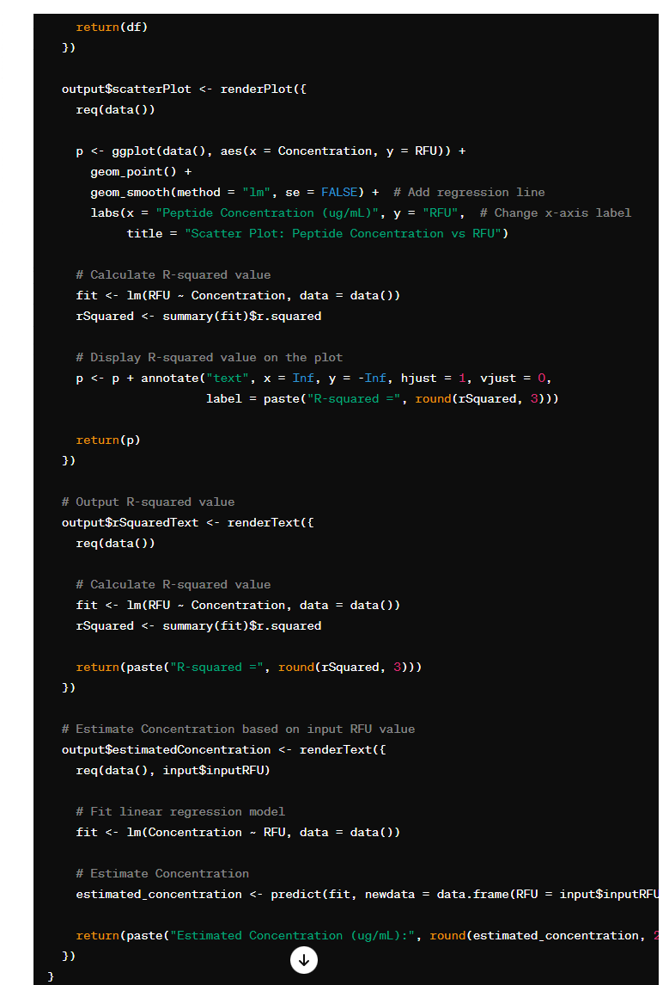
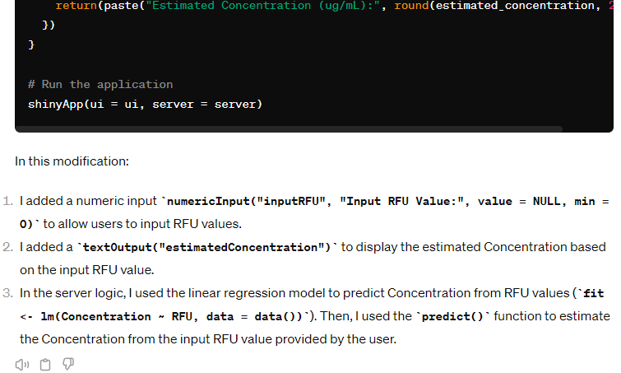

Slide 23
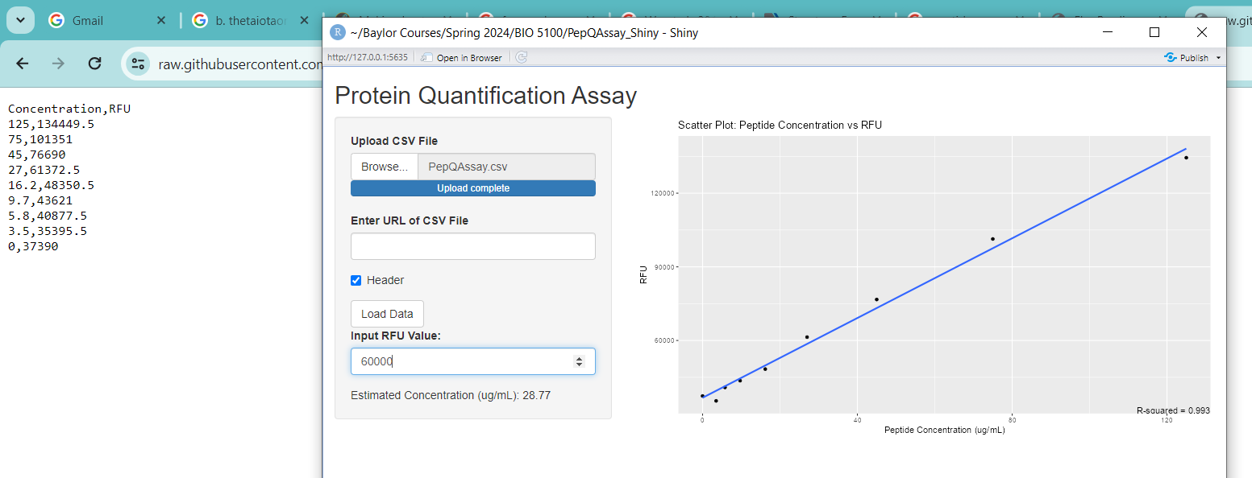
Returns good estimate of the peptide concentration (ug/mL)

Slide 24

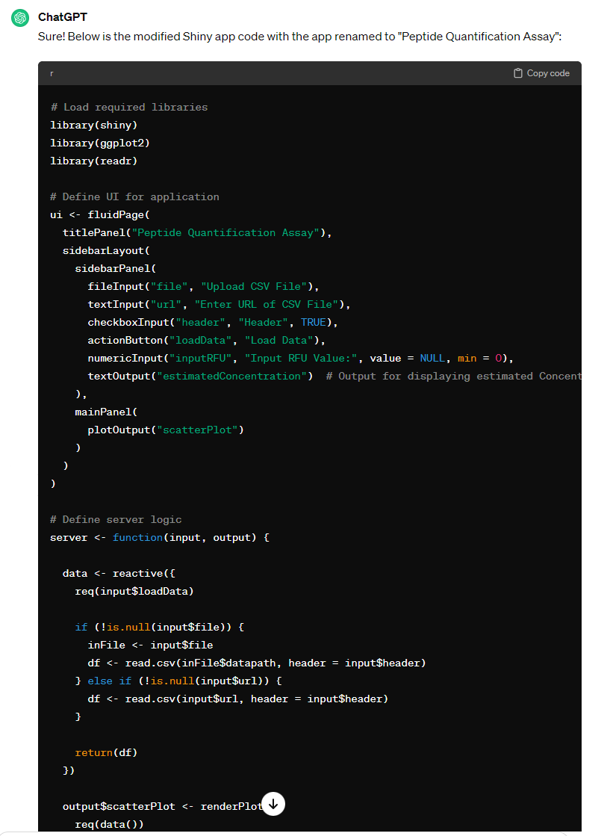
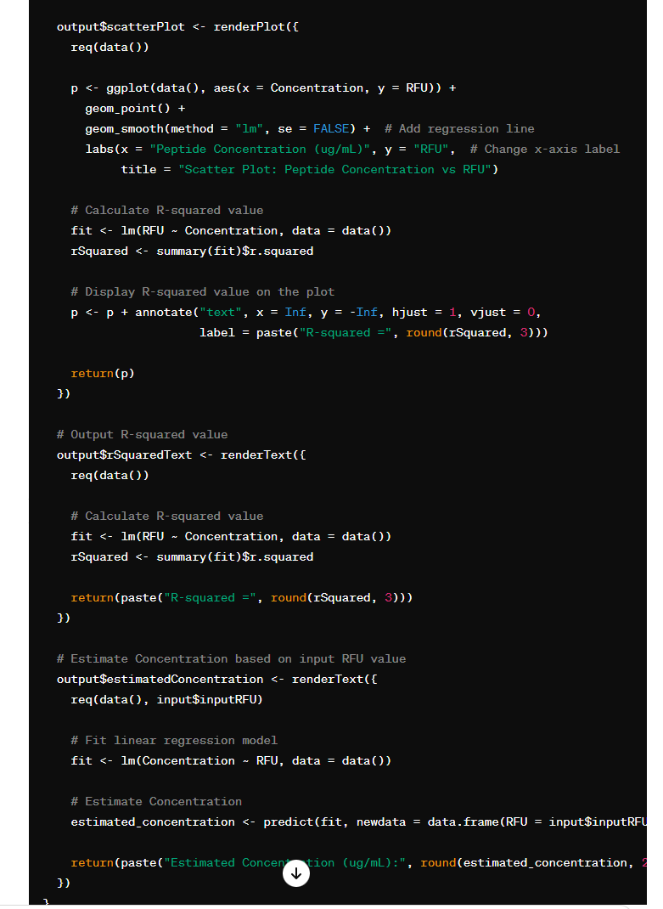
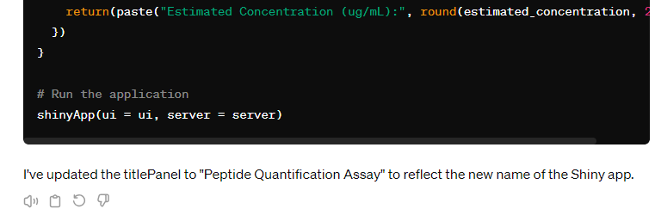
Renaming App

Slide 25
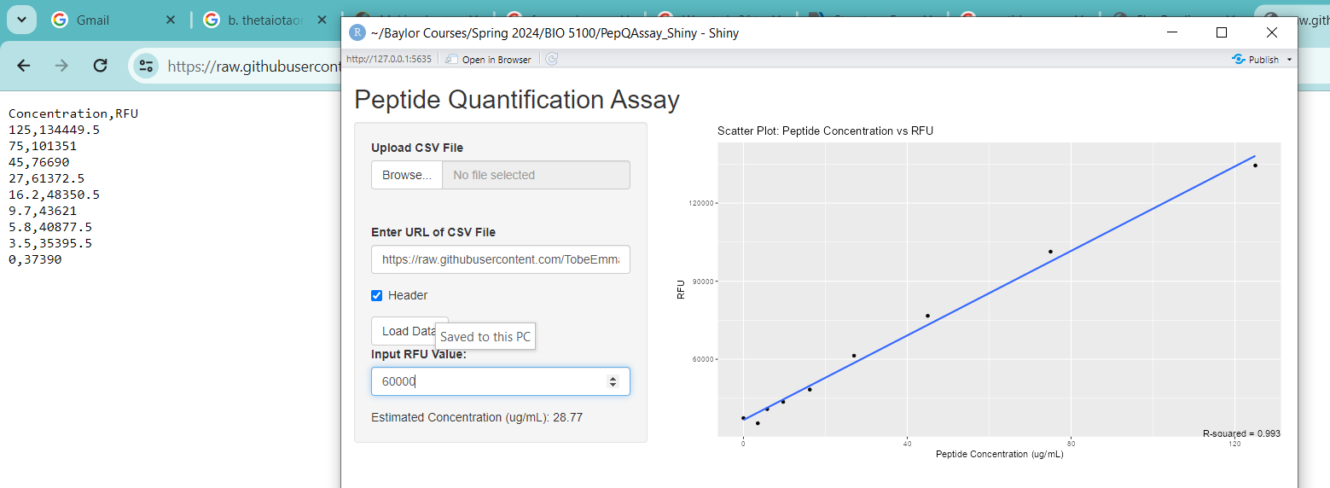
Returns Good Estimate of the peptide Concentration (ug/mL)

Slide 26
Conclusions
I was able to successfully prompt ChatGPT to generate R codes to create a shiny app named “PeptideQuant” that meets the study objectives
I was also able to demonstrate prompts that led ChatGPT to generate functional codes and nonfunctional codes.
Based on this study, ChatGPT can generate functional R codes for shiny apps if given the right prompt.

Slide 27

Thank You for Listening

